Slide 1

Project Title:
Smart Real-Time Logistics Q&A System using Pathway and RAG-based LLM Retrieval for Managers.

Slide 2
Problem Statement:
Logistics and supply chain operations involve constant tracking, exception handling, and adherence to operational policies. However, the data is often spread across streaming systems (e.g., shipment status updates) and static documents (e.g., company policy PDFs). This fragmentation makes it difficult for support agents or automated systems to answer real-time operational questions effectively.
We address this issue by creating a retrieval-augmented generation (RAG) system that integrates real-time data ingestion using Pathway with LLM-based Q&A over both streaming CSVs and static PDF policies.

Slide 3
Domain
Primary Domain: Supply Chain and Logistics
Sub-Domain: Real-time Shipment Tracking, Intelligent Querying, Compliance Automation

Slide 4
Objectives
Ingest real-time shipping updates using a streaming pipeline.
Extract structured policy clauses from company PDFs.
Build an embedding-based document retrieval system (FAISS + SentenceTransformers).
Integrate an LLM (OpenAI GPT) for natural language querying over both policy and shipment data.
Simulate a dynamic shipping environment to test real-time Q&A capabilities.

Slide 5
Project Components

Slide 6
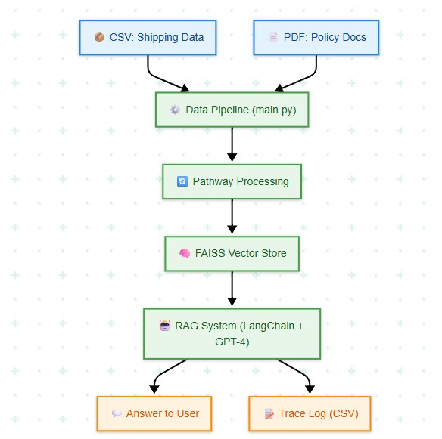
System Architecture
Simulated live CSV stream
Policy PDF extraction
Embedding + FAISS index creation
RAG query interface using OpenAI LLM

Slide 7
Streaming Ingestion (Pathway)

Slide 8
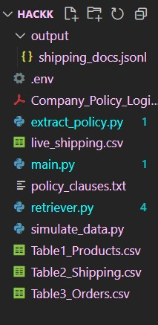
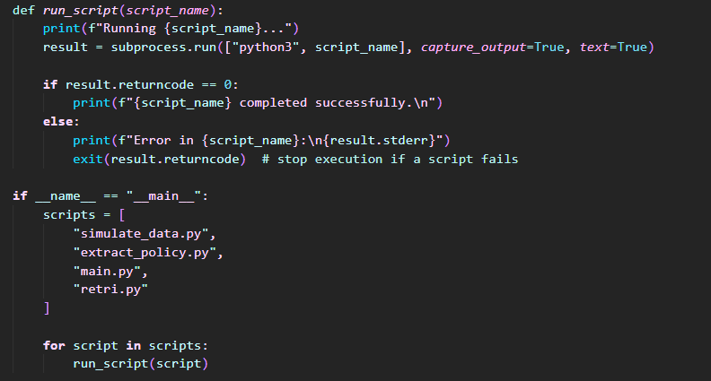
RUNNING THE SCRIPT

Slide 9
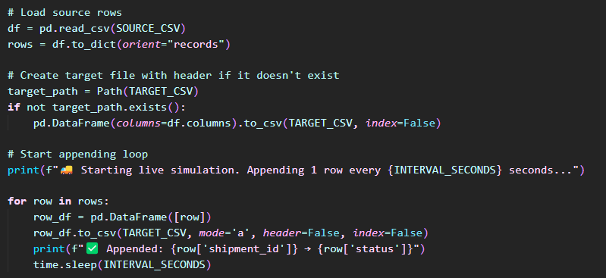
Simulating Data

Slide 10
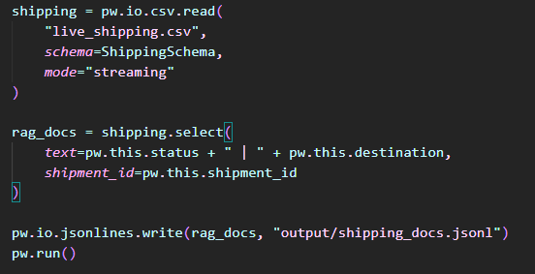
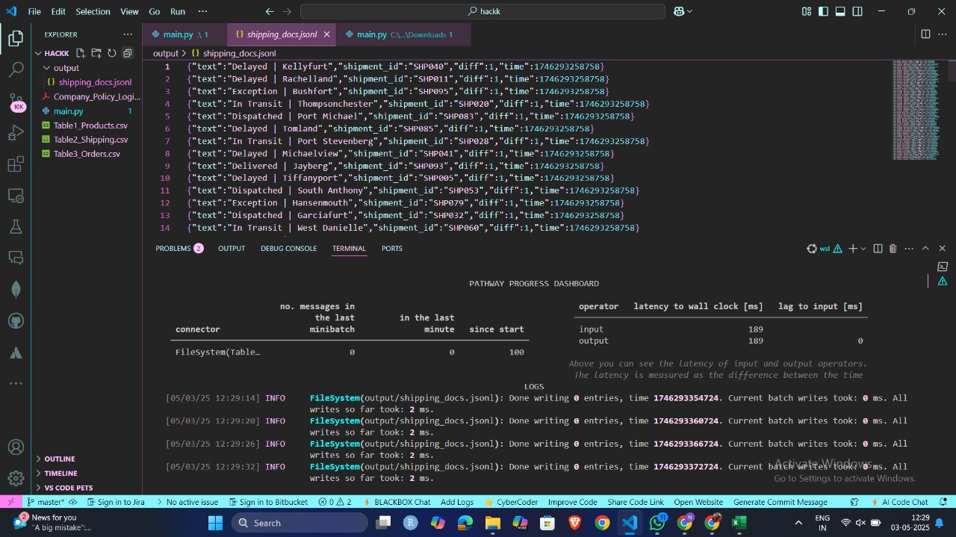

Slide 11
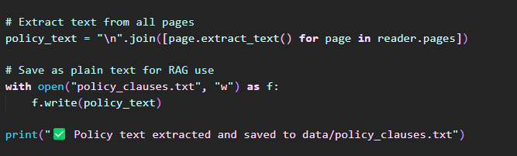
PDF Parsing

Slide 12
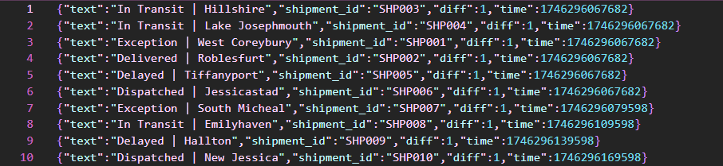
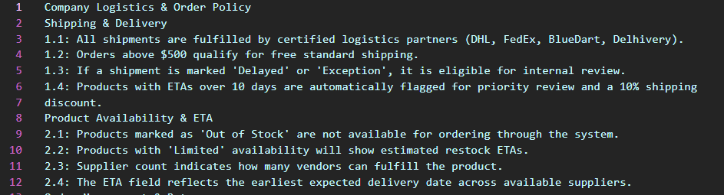

Slide 13
DATA INGESTION

Slide 14
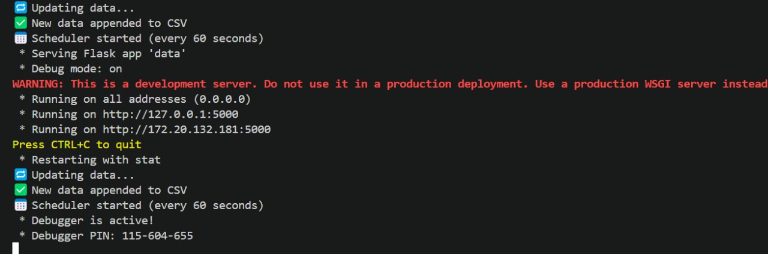
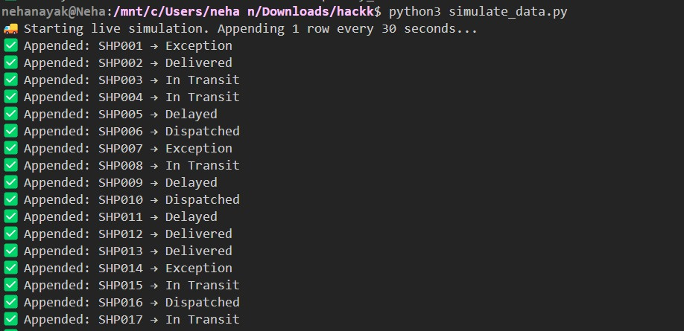

Slide 15
QUERYING USING RAG + LLM

Slide 16
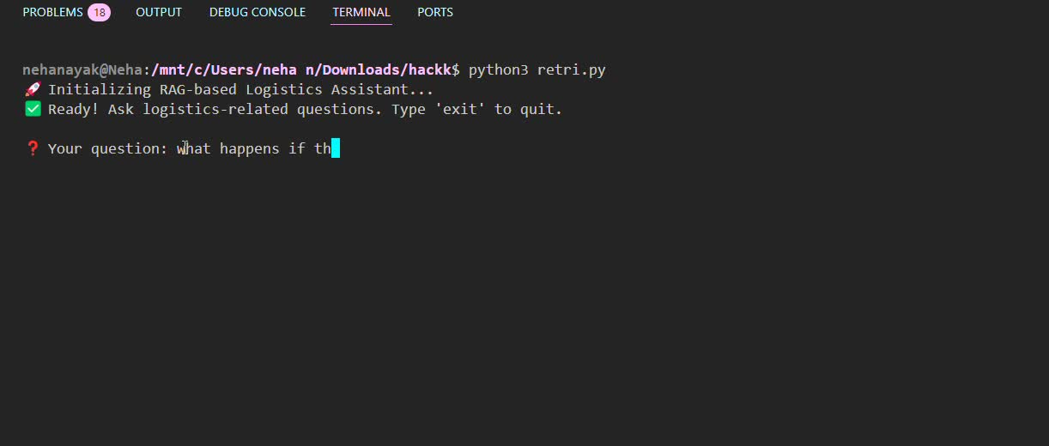

Slide 17
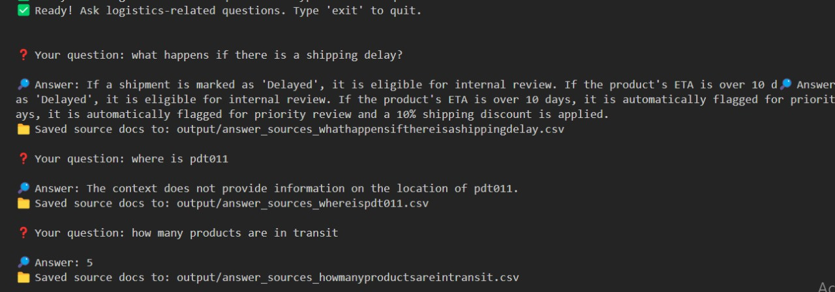
PERFORMING QUERY IN REAL TIME

Slide 18
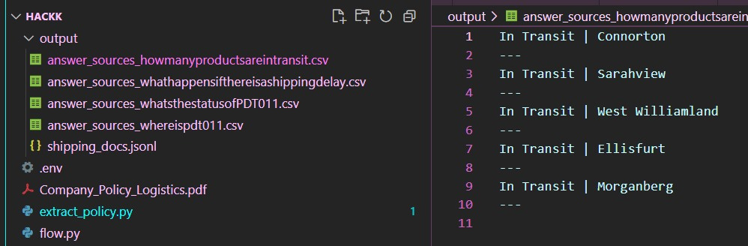
QUERY O/P STRORED IN REAL TIME AS CSV

Slide 19
THANKYOU!

